Slide 1

SMART ENERGY METER

Slide 2

PROBLEM STATEMENT
Traditional energy meters require manual readings and lack real-time monitoring. This project aims to develop a smart energy meter that enables remote monitoring of voltage, current, power consumption, and cost using the Blynk app. The system provides a cost-effective solution for efficient energy management

Slide 3
ABSTRACT
This project focuses on designing a smart energy meter using an ESP8266, an ACS712 current sensor, and a ZMPT101B voltage sensor. The data is processed and displayed in real-time on the Blynk IoT platform, allowing users to monitor energy consumption remotely. The system calculates power usage in kWh and estimates the cost based on a predefined rate. Future enhancements may include automated alerts, predictive analytics, and integration with smart home system

Slide 4
INTRODUCTION
A smart energy meter automates the measurement of electricity consumption and provides real-time monitoring through the Internet of Things (IoT). The ESP8266 WiFi module sends energy data to the Blynk cloud, enabling users to access their electricity usage from anywhere. This system offers an efficient way to track power consumption and optimize energy use, reducing electricity bills and promoting sustainability.

Slide 5
KEY FEATURE
Real-Time Monitoring: View voltage, current, power, and energy usage on the Blynk app.
Wireless Connectivity: Uses ESP8266 WiFi module for remote access.
Energy Cost Estimation: Calculates electricity consumption cost dynamically.
User-Friendly Interface: Accessible through smartphones via Blynk.
Data Logging: Stores power usage history for future analysis.
Compact & Cost-Effective: Uses readily available low-cost components.

Slide 6
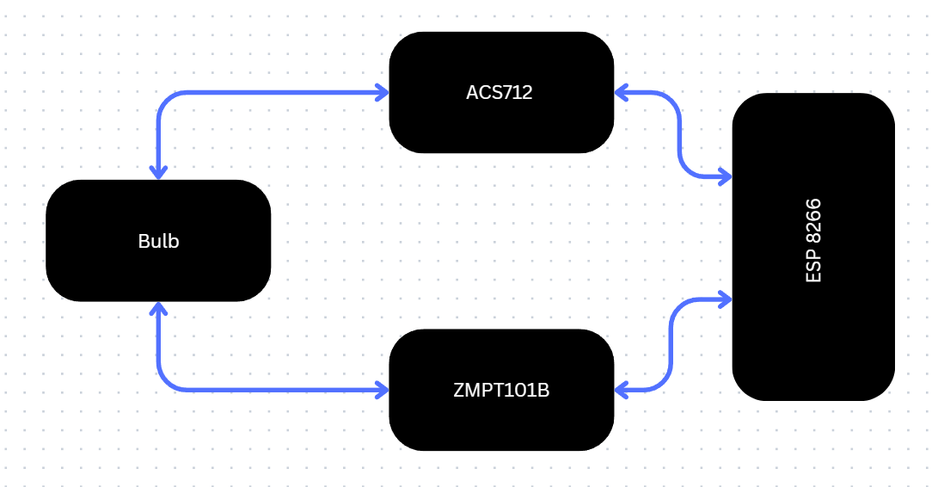
BLOCK DIAGRAM

Slide 7
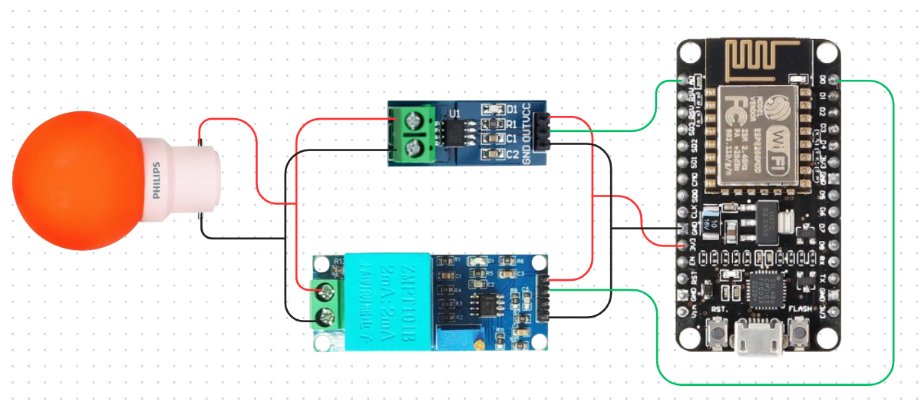
CIRCUIT DIAGRAM

Slide 8
USE CASE
Home Energy Management – Track and optimize electricity usage.
Industrial Power Monitoring – Monitor factory and office power consumption.
Smart Grid Integration – Improve energy distribution efficiency.
Sustainable Energy Solutions – Promote energy conservation and efficiency.
Billing & Cost Analysis – Estimate electricity expenses accurately.

Slide 9
OUTCOME
Remote Monitoring: Users can check real-time energy consumption from anywhere.
Accurate Measurements: Reliable voltage and current readings with ACS712 & ZMPT101B sensors.
Cost Estimation: Real-time calculation of energy costs for better financial planning.
Data Storage: Power usage data logged for long-term analysis.
Scalability: Can be integrated into smart home automation and energy management systems.

Slide 10
CONCLUSION
The smart energy meter using ESP8266 and Blynk successfully provides real-time energy monitoring, cost estimation, and remote access. It enhances energy management and can be further expanded with automated alerts, predictive analytics, and AI-based power optimization. This project contributes to the development of IoT-based smart grid solutions, promoting energy efficiency and sustainability.

